Slide 1
COMPLEX NUMBERS
CONTENTS
What is complex number?
Basic operations on complex numbers
Trigonometric form ( Polar form)
De Moivre’s Theorem
Roots of complex numbers
Applications

Slide 2



What is complex number?
The complex numbers arise when we try to solve equations such as .
.
A complex number is a number of the form

Slide 3
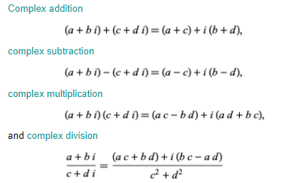
Basic operations on complex numbers

Slide 4

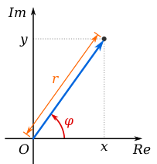


Trigonometric form ( Polar form)
The absolute value ( magnitude) of a complex number
The argument of z ( φ) is the angle of the radius Oz with the positive real axis

Slide 5
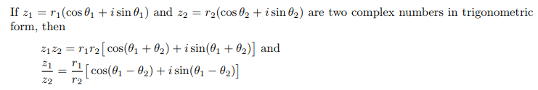
Products and Quotients of Two Complex Numbers in trigonometric form

Slide 6


De Moivre’s Theorem
Set x=3ϴ and n=3

Slide 7
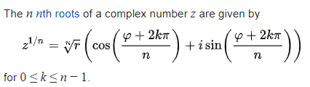


Roots of complex numbers

Slide 8
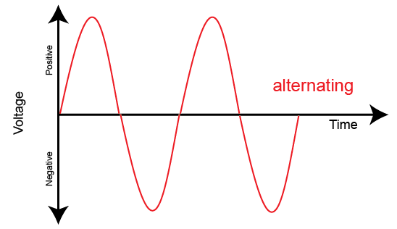
Applications
1) Signal Processing
2) AC circuit analysis
3) Quantum Mechanics and etc.

Slide 9
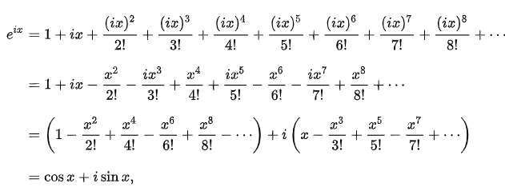
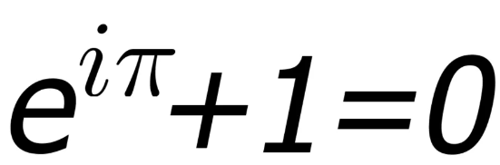
Euler’s Identity

Slide 10

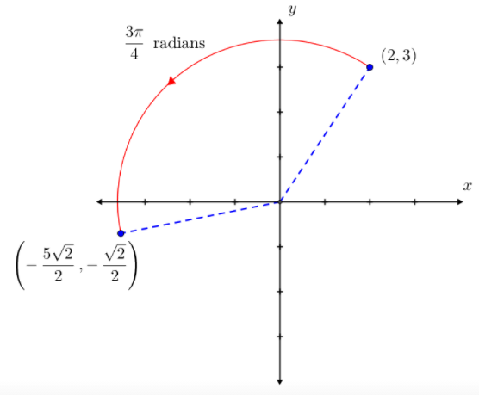
Examples

Slide 11
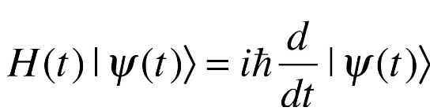
Quantum mechanics

Slide 12

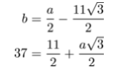
Examples-2

Slide 13
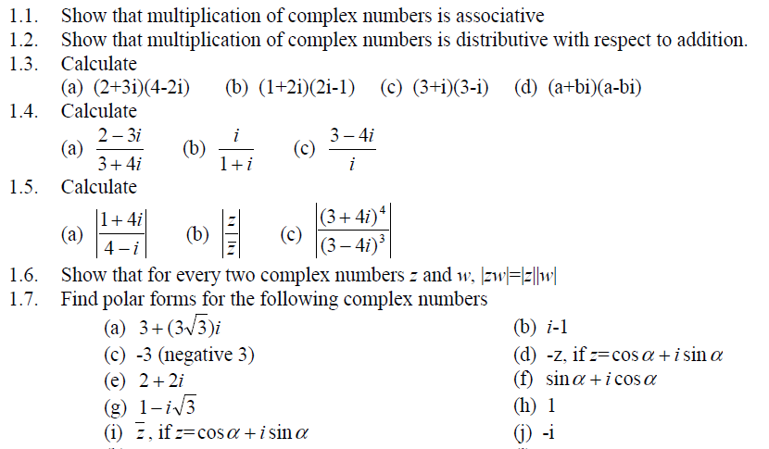
Practice-1

Slide 14
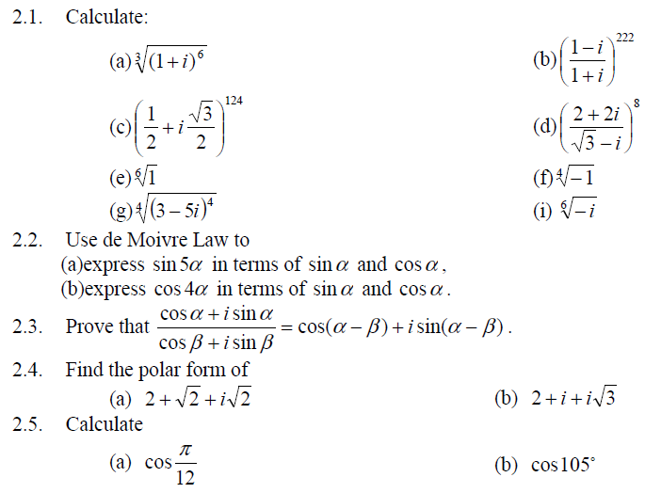
Practice-2

Slide 15
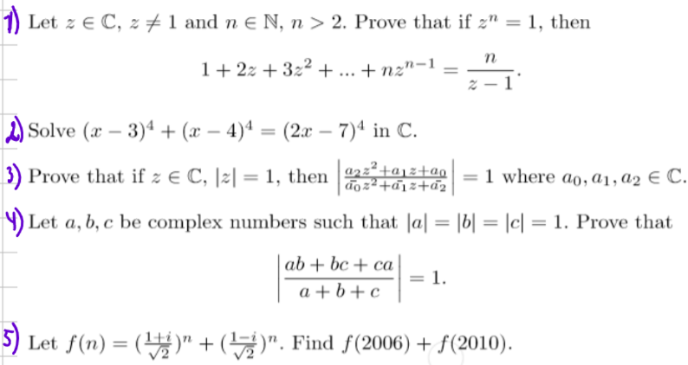
Practice-3 ( hard)

Slide 16





Further Applications
Evaluate integrals involving trigonometric functions

Slide 17
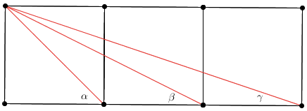

Three squares problem
$$α+β+γ=?$$

Slide 18
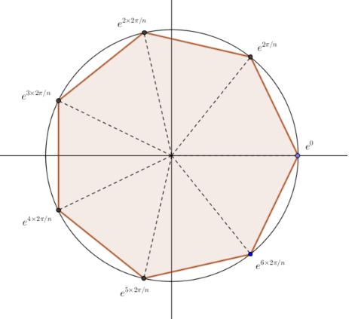
Complex Roots of Unity
Complex Roots of Unity are Vertices of Regular Polygon Inscribed in Circle

Slide 19



Complex numbers in geometry

